Slide 1
FIRE FIGHTING ROBOT

Slide 2
ABSTRACT
The FIRE FIGHTING robot made under this project can move in both forward and reverse direction and can turned in left and right directions. Thus, we can operate a robot over a very long distance and there is no need for human to go even near the area on fire. We have used the flame sensing element for detection of fire. It is the highly sensitive device and is capable for detecting very small fires too. The robot accommodates a wireless sensor network on itself to extinguish fire. The main aim of the project will be to design a Fire Fighting Robot toolkit which can replace the traditional Fire.

Slide 3
EXISTING SYSTEM
This robot which designed to detect the source of fire, extinguish it and increase the knowledge about fire behavior from the incident area The whole system is programmed using an Arduino UNO board (ATmega328P microcontroller) which forms the brain of the system.

Slide 4
Disadvantages of Existing Robot
Wireless sensor is not used here
This system is not efficient
No monitoring system for this vehicle

Slide 5
PROPOSED SYSTEM
This robot which designed to detect the source of fire, extinguish it and increase the knowledge about fire behavior from the incident area Thewhole system is programmed using an Arduino UNO board (ATmega328P microcontroller) which forms the brain of the system.

Slide 6
Advantages of Proposed System
Not sensitive to Light
Wit can pass through solids to longer range
Capability of sensing accurately with increased flexibility
Not sensitive to weather conditions

Slide 7
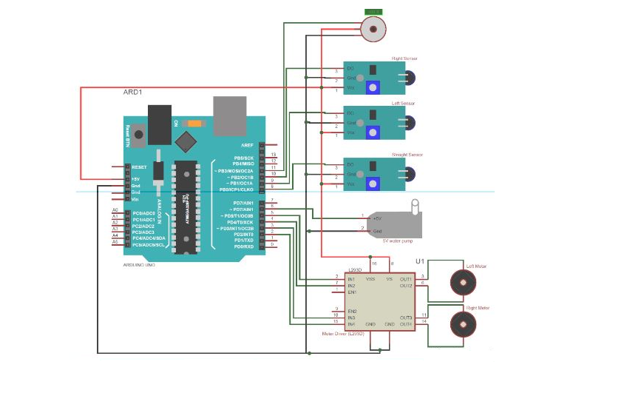
ARCHITECTURE DIAGRAM

Slide 8
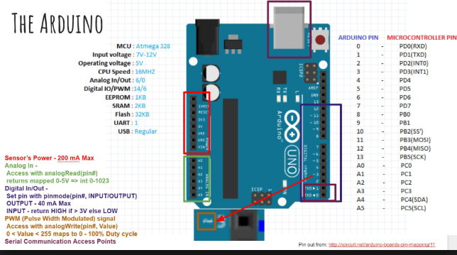
PIN CONFIGURATION DIAGRAM

Slide 9
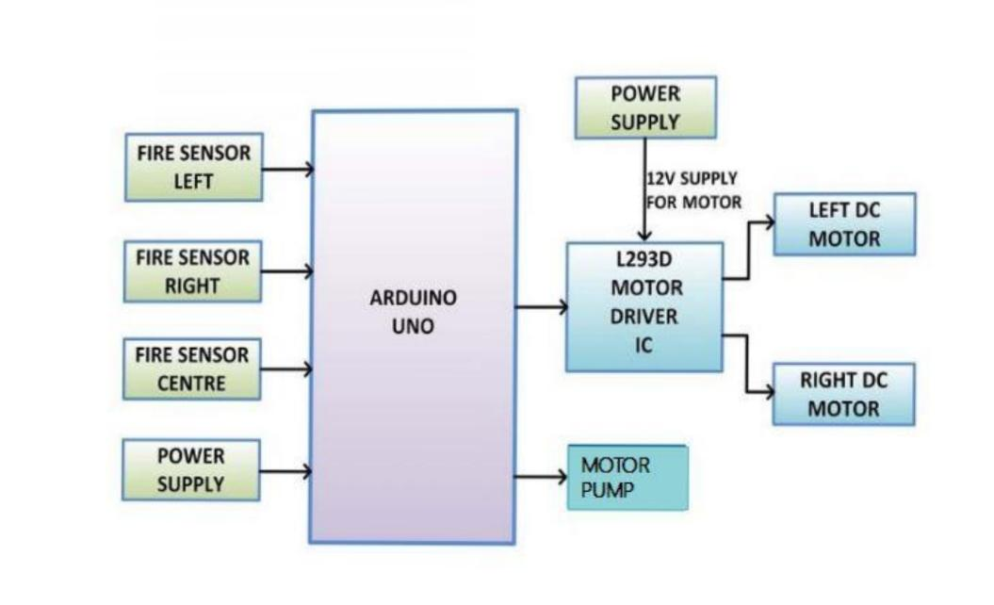
WORKFLOW DIAGRAM

Slide 10
MODULE DESCRIPTION
ARDUINO UNO
FIRE SENSOR
L293D MOTOR DRIVER
WATER PUMP

Slide 11
ARDUINO UNO
The Arduino Uno is a microcontroller board based on the ATmega328.
It has 14 digital input/output pins 6 analog inputs, a 16 MHz ceramic resonator, a USB connection, a power jack, an ICSP header, and a reset button.
It contains everything needed to support the microcontroller; simply connect it to a computer with a USB cable

Slide 12
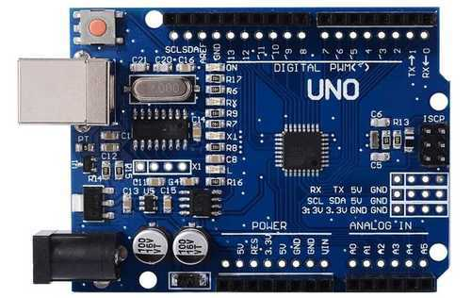
ARDUINO UNO

Slide 13
FIRE SENSOR
Designed to detect and respond to presence of flame.
Response to flame depend on installation.
A flame detector can often respond faster and more accurately than a smoke or heat detector due to the mechanisms it uses to detect the flame.

Slide 14
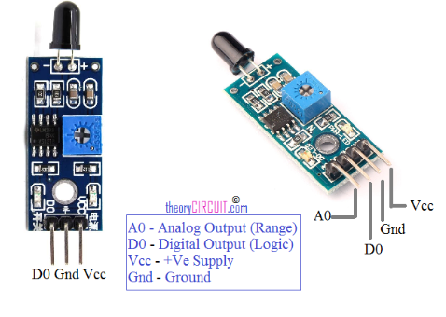
FIRE SENSOR

Slide 15
DC WATER PUMP
Pumps water when an abnormal conditions arises in the system.
When temperature exceeds flame detected and pump turned on.
A pump motor is a DC motor device that moves fluids. A DC motor converts direct current electrical power into mechanical power.
FEATURES
Reduced noise
Available in DC and AC
Supply voltage: +12VDC
Supply voltage: 230V AC

Slide 16
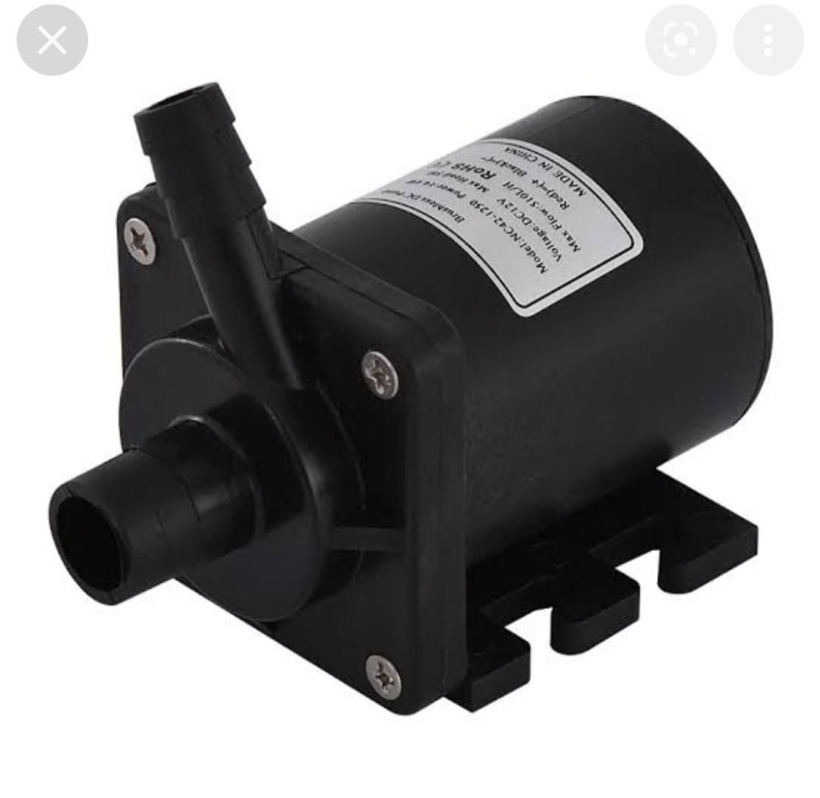
DC WATER PUMP

Slide 17
L293D MOTOR DRIVER
L293D is a motor driver IC.
Motor driver take low current and provide high current.
This higher current signal is used to drive motors.

Slide 18
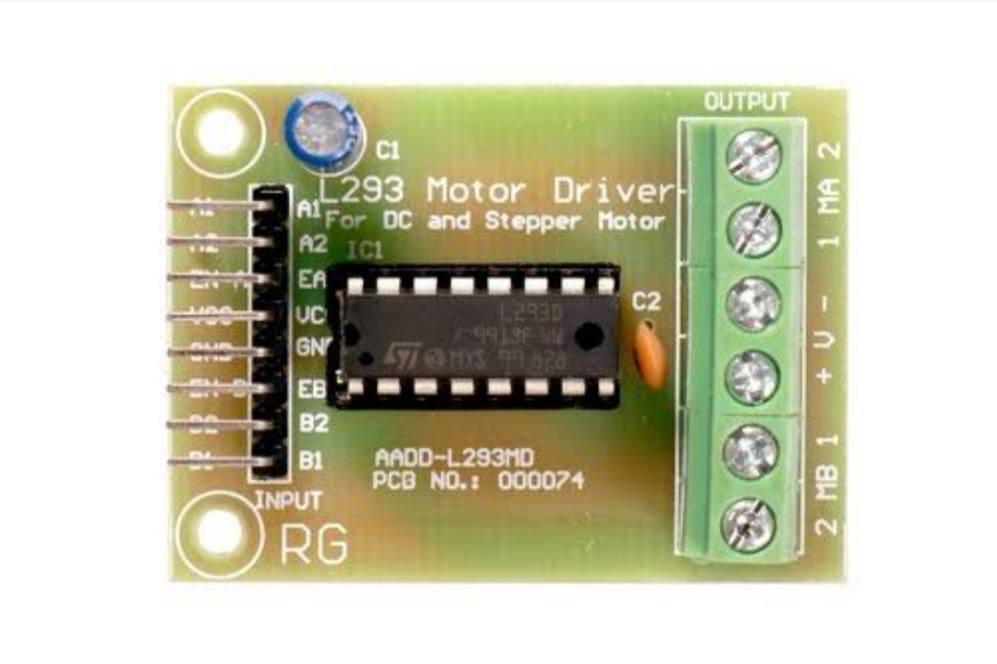
MOTOR DRIVER

Slide 19
SOFTWARE REQUIREMENTS
Embedded C
Arduino IDE

Slide 20
EMBEDDED C
Embedded C is most popular programming language in software field for developing electronic gadgets. Each processor used in electronic system is associated with embedded software.
Embedded C programming plays a key role in performing specific function by the processor. In day-to-day life we used many electronic devices such as mobile phone, washing machine, digital camera, etc. These all device working is based on microcontroller that are programmed by embedded C.

Slide 21
ARDUINO IDE
Arduino is an open-source platform used for building electronics projects. Arduino consists of both a physical programmable circuit board (often referred to as a microcontroller) and a piece of software, or IDE (Integrated Development Environment) that runs on your computer, used to write and upload computer code to the physical board.
The Arduino platform has become quite popular with people just starting out with electronics, and for good reason. Unlike most previous programmable circuit boards, the Arduino does not need a separate piece of hardware (called a programmer) in order to load new code onto the board – you can simply use a USB cable. Additionally, the Arduino IDE uses a simplified version of C++, making it easier to learn to program. Finally, Arduino provides a standard form factor that breaks out the functions of the micro-controller into a more accessible package.

Slide 22
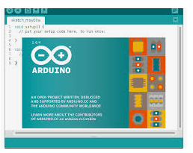
Screenshot Of Arduino IDE

Slide 23
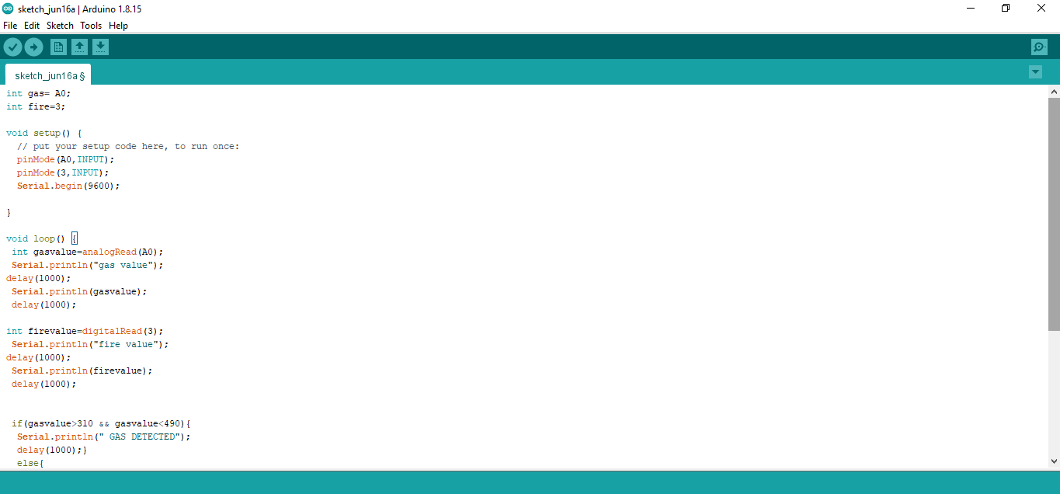
Screenshot of coding

Slide 24
RESULT
The result shows that higher efficiency is indeed achieved using the embedded system.
With a common digitalized platform, these instruments will enable increased flexibility in control, operation, and expansion; allow for embedded intelligence.
Remote control of robot.
It can be enhanced by interfacing it with a wireless camera.

Slide 25

Conference Certificate

Slide 26
Thank you…

